Slide 1
Computer Vision Fundamentals
Lecture 4 - Part 2
Noise

Slide 2
Contents
Introduction to noise
Types of noise
Salt and pepper noise
Gaussian noise
Speckle noise
Periodic noise

Slide 3
Introduction to Noise
We may define noise to be any degradation in the image signal, caused by external disturbance.
These errors will appear on the image output in different ways depending on the type of disturbance in the signal.
Usually we know what type of errors to expect, and hence the type of noise on the image; hence we can choose the most appropriate method for reducing the effects.
Cleaning an image corrupted by noise is thus an important area of image restoration.

Slide 4
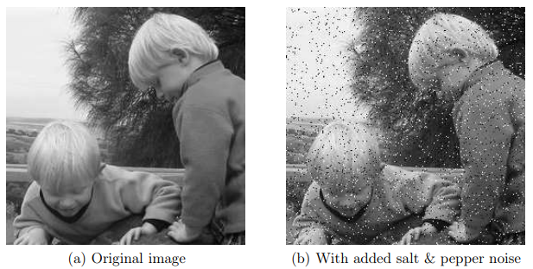
Types of Noise
Salt and pepper noise
Also called impulse noise, shot noise, or binary noise. This degradation can be caused by sharp, sudden disturbances in the image signal; its appearance is randomly scattered white or black (or both) pixels over the image.

Slide 5
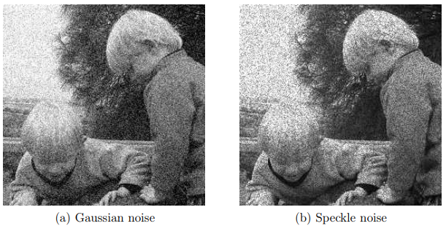
Types of Noise
Gaussian noise
Gaussian noise is an idealized form of white noise, which is caused by random fluctuations in the signals
Speckle Noise
Speckle noise Whereas Gaussian noise can be modelled by random values added to an image; speckle noise can be modelled by random values multiplied by pixel values, hence it is also called multiplicative noise. Speckle noise is a major problem in some radar applications.

Slide 6
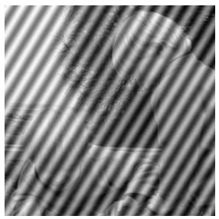
Types of Noise
Periodic Noise
If the image signal is subject to a periodic, rather than a random disturbance, we might obtain an image corrupted by periodic noise. The effect is of bars over the images

Slide 7
Thankyou

